Slide 1
First Look: MariaDB Docker Images and Kubernetes Helm Charts
Thomas Boyd
Technical Marketing

Slide 2
Agenda
Containers, Docker & Kubernetes
Demos
MariaDB Server Docker
MariaDB ColumnStore Docker
MariaDB TX Docker Compose
MariaDB AX Docker Compose
Kubernetes, Stateful Apps & MariaDB
Future Direction
MariaDB TX on Kubernetes via Helm Chart
Q & A

Slide 3
Containers, Docker & Kubernetes
Brief overview of core technologies

Slide 4
What do Containers give me?
Encapsulation of Dependencies
O/S packages & Patches
Execution environment (e.g. Python 2.7)
Application Code & Dependencies
Process Isolation
Isolate the process from anything else running
Faster, Lightweight virtualization

Slide 5
Dockerfile - Example
FROM python:2.7
ADD . /code
WORKDIR /code
RUN apt-get update && apt-get -y install python-dev libssl-dev
RUN pip install --no-cache-dir -r requirements.txt
EXPOSE 5000
CMD python app.py
Notes:
Baking in all dependencies
Operating System
Code Dependencies

Slide 6
Virtual Machines vs. Containers
App 1
App 2
App 3
Bins/Libs
Bins/Libs
Bins/Libs
Guest OS
Guest OS
Guest OS
App 1
App 2
App 3
Bins/Libs
Bins/Libs
Bins/Libs
Hypervisor
Docker Engine
Host Operating System
Operating System
Infrastructure
Infrastructure
Notes:
Factoid to drop
10-20 x better density

Slide 7
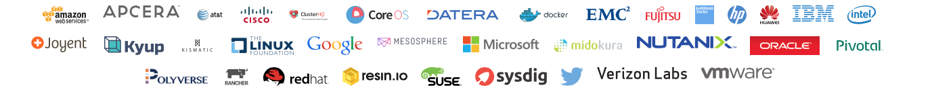
Open Container Initiative (OCI) – Polyglot Vendors
Coalition of industry leaders join forces to eliminate fragmentation
Form a vendor-neutral, open source governance model under the Linux Foundation
Establish common standards for container format and runtime
Docker donated its container format, runtime and associated specifications
Appoint maintainers for the libcontainer project
Notes:
Can now run in Docker, GCE, AWS Containers

Slide 8
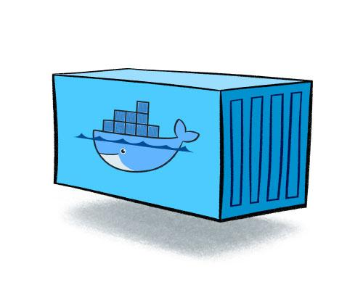


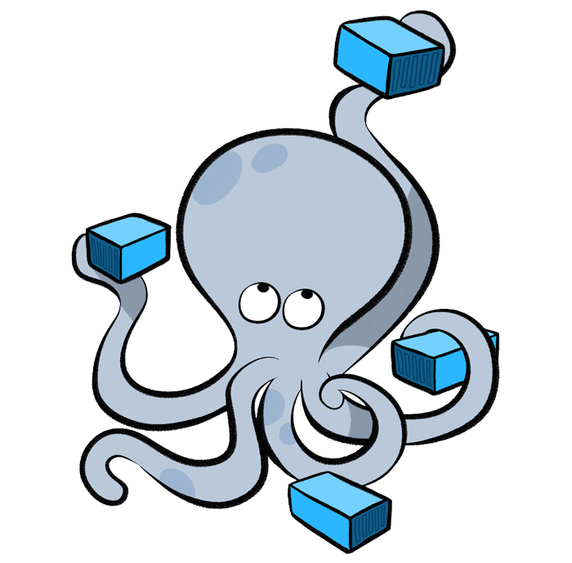
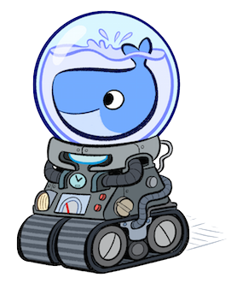
Docker Toolchain in pictures
Docker Swarm
Images encapsulates your code, dependencies…
Containers instantiate an image and are run by Docker Engine
Swarm clusters Docker Engines
Image
Compose orchestrates Container deployment
Docker Engine
Machine provisions Docker Engines
Docker Machine
Docker Compose

Slide 9
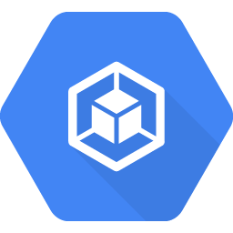





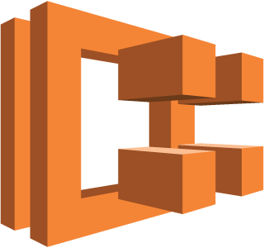

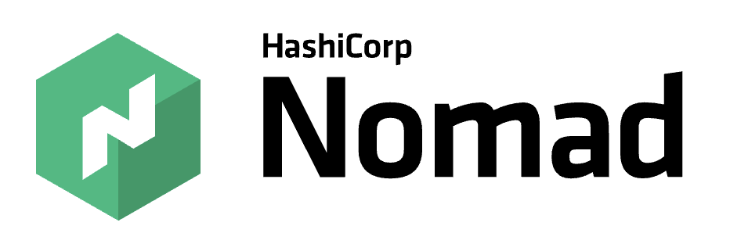

Orchestration/Management
Google Container
Engine
Azure Container Service
Amazon ECS
Notes:
Can now run in Docker, GCE, AWS Containers

Slide 10
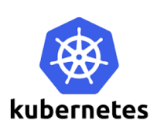

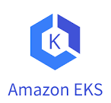
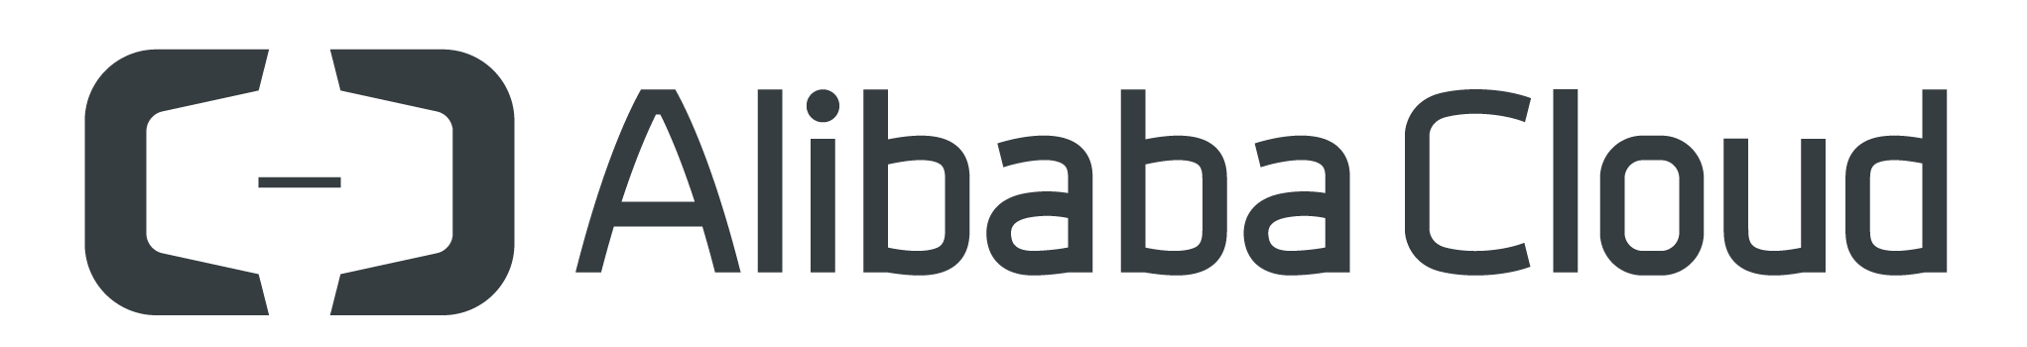
Orchestration/Management - Kubernetes Everywhere
?
Google Container
Engine
?
?
Azure Container Service
Amazon ECS
Azure Kubernetes Service
Notes:
Can now run in Docker, GCE, AWS Containers

Slide 11
Stateful / Persistent
Ephemeral
versus

Slide 12
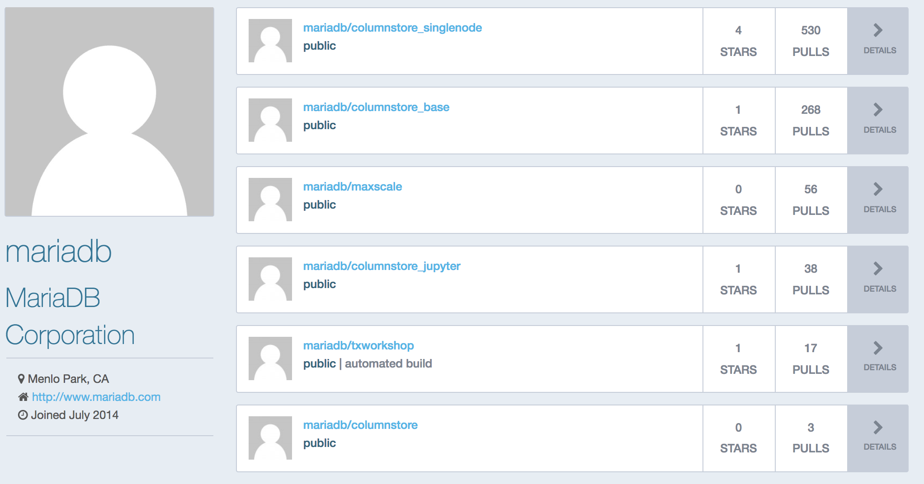
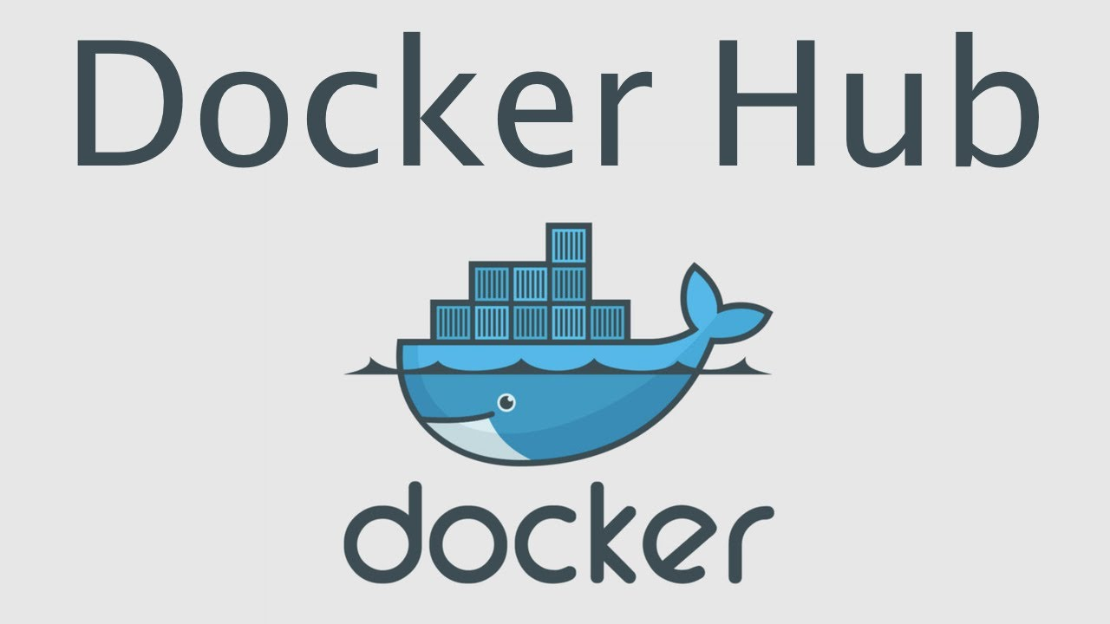
MariaDB Corp
Docker Hub
https://hub.docker.com/u/mariadb/

Slide 13
MariaDB Server Docker Demo
Standalone MariaDB Server for Dev/Test

Slide 14
MariaDB Server Demo Steps
Pull and Run the image
Connect CLI and interact
Examine Dockerfile and docker-entrypoint.sh
Docker ps, docker volumes, pruning, ect...

Slide 15
MariaDB ColumnStore Docker Demo
Standalone MariaDB Columnstore for Dev/Test

Slide 16
MariaDB ColumnStore Demo Steps
Pull and Run the image
Connect CLI and interact
Examine Dockerfile and docker-entrypoint.sh
Mcsadmin, etc...

Slide 17
MariaDB TX Sandbox Demo
Standalone Server plus Adminer UI

Slide 18
Docker Compose
– MariaDB TX sandbox –
Container #1
Container #2
Adminer
MariaDB
Server

Slide 19
MariaDB AX Docker Compose Demo
Four Node AX + Apache Zeppelin

Slide 20
Docker Compose
– MariaDB AX sandbox –
Container #2
Container #4
MariaDB ColumnStore
(UM, query)
MariaDB ColumnStore
(PM, storage)
Container #1
Apache
Zeppelin
Container #3
Container #5
MariaDB ColumnStore
(UM, query)
MariaDB ColumnStore
(PM, storage)

Slide 21
Kubernetes, Stateful Apps & MariaDB
Deeper dive on Kubernetes & MariaDB

Slide 22
Kubernetes
Kubernetes and containers have become the de-facto platform for modern application deployment.
Historically running databases has been challenging to work around frameworks optimized for ephemeral state.
Several cross industry led initiatives are providing solutions for addressing historic challenges:
Persistent Volumes and Persistent Volume Claims
Persistent Volume providers providing intelligent data distribution and snapshotting.
Storage snapshots becoming a first class Kubernetes capability.
Operator SDK to simplify deployment and ongoing day 2 operations such as backups
MariaDB is building out container and kubernetes support to help embrace this move.
MariaDB can enhance the underlying products to be more container friendly.

Slide 23
Kubernetes
– terminology –
Pod: a single instance of an application run as a container (or set of containers).
Deployment: describes a desired state for a set of N pods that share storage
Stateful set: a deployment type with stable identity, network and storage.
Persistent Volume: a pre-provisioned storage volume / directory available for consumption by containers running within pods
Persistent Volume Claim: A pod request to consume storage from a persistent volume
Service: a logical set of pods plus a means of access

Slide 24
Kubernetes
– terminology applied to MariaDB –
Pod: a container with an instance of MariaDB Server or MaxScale
Deployment: a request to deploy two MariaDB MaxScale instances (HA)
Stateful set: a request to deploy three MariaDB Server instances (one master with two slaves for HA) with persistent storage
Persistent Volume: storage attached to each MariaDB Server instance
Persistent Volume Claim: request for storage by a container w/ MariaDB Server
Service: MariaDB MaxScale instances exposed on port 3306 for external access,
and MariaDB Server instances for internal access
Notes:
A pod will run the MariaDB Server or MaxScale process together with non-critical “sidecar” containers that provide state management and monitoring services.
A persistent volume survives the restart of a pod. In a StatefulSet it gets attached to a pod with the same host name as the pod that failed.
A persistent volume claim is a template for provisioning a persistent volume of a selected size and storage class.

Slide 25
Kubernetes
– components –
Master
Node
kube-api-server
etcd
kube-scheduler
kube-controller-manager
kubelet
kube-proxy
Container runtime

Slide 26
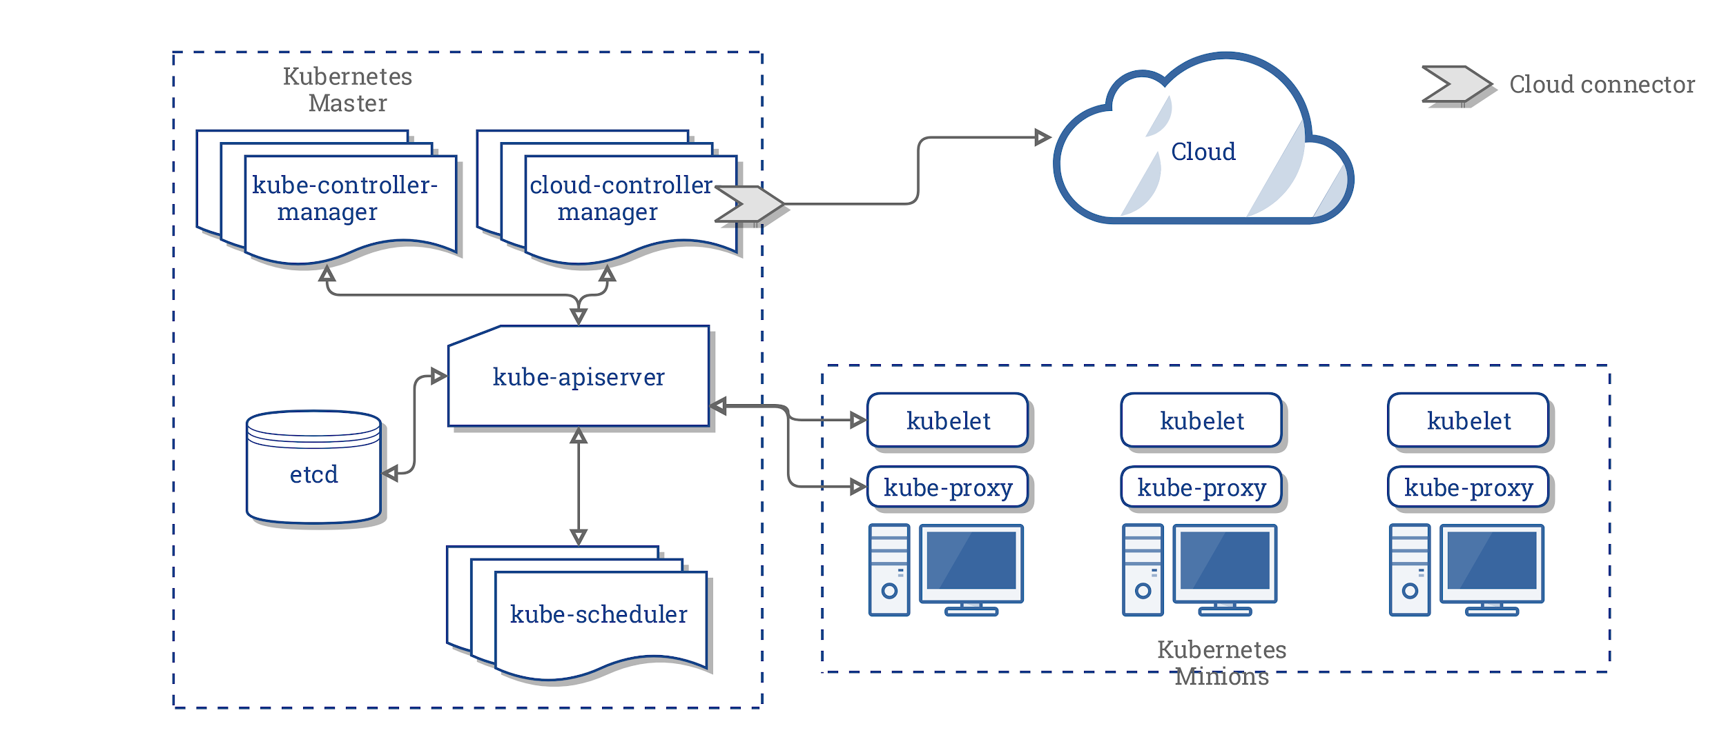

Slide 27
Deployments and
stateful sets
Master
Node(s)
Spec
Pod
Service
Spec
Controller
Pod
Port
Spec
Pod

Slide 28
MariaDB on containers
– what can you do now –
Docker
Kubernetes
Official Docker images for:
MariaDB Server
MariaDB MaxScale
MariaDB ColumnStore
Docker Compose:
MariaDB TX sandbox
MariaDB AX sandbox
Helm chart supports:
MariaDB Server (standalone)
MariaDB Server (master, slave)
Upcoming support for:
MariaDB TX cluster
MariaDB AX
Notes:
One Helm chart supports deployment of multiple templates, new templates are being added.

Slide 29
Docker Compose
– deploying the MariaDB TX sandbox –
docker-compose up --build
UI (Adminer)
http://localhost:8080/?server=server&username=sandbox&db=bookstore
password: highlyillogical
CLI
mysql -h127.0.0.1 -usandbox -phighlyillogical -D bookstore

Slide 30
Docker Compose
– deploying the MariaDB AX sandbox –
git clone https://github.com/mariadb-corporation/mariadb-columnstore-docker.git
cd columnstore_zeppelin
docker build -t mariadb/columnstore:latest ../columnstore
docker build -t mariadb/columnstore_zeppelin:latest ../columnstore_zeppelin
docker-compose up --build
docker logs -f columnstore_zeppelin_um1_1
UI (Apache Zeppelin)
http://localhost:8080/
CLI
mysql -h127.0.0.1 -uzeppelin_user -pzeppelin_pass bookstore

Slide 31
Why Use StatefulSets for DB instances?
Stability
Stable DNS of Pods
Persistent volumes
Defined order of instantiation
Scaling, Self-healing
Failed pods are replaced automagically
The number of pods is governed by a single parameter
Identical Configuration on Pods
Main service (e.g. mysqld)
Supporting services (e.g. prometheus export for monitoring, fluentd for logging)
Notes:
stable DNS: when a pod fails a new pod is started with the same FQDN
persistent volumes: when a pod fails, a persistent volume is mounted on its replacement
pods are initially started in the same order as defined

Slide 32
Challenges for DB Containers
StatefulSet
Identical pods: additional scripting required to instantiate different roles
Complete enterprise cluster requires more StatefulSets (MaxScale+Master/Slave)
Persistence
Persistent volumes add new layers of abstraction (and latency)
e.g. GlusterFS: volume on top of a DFS on top of a FS on top of a block device
Provisioning of IOPS or throughput is vendor-specific
Resource Management
DB instances contend with other apps for CPU, RAM, network and I/O resources
CPU and memory requests/limits available but do not provide guarantees
Throttling network and IOPS not available yet
Container restarted when over memory limits (DB engine configuration needed to ensure memory limits are not exceeded)

Slide 33
MariaDB TX Helm and
Kubernetes Screens
Modern database meets modern ops platform

Slide 34
Kubernetes
– MariaDB TX –
Deployment
Stateful set
Pod #2
MariaDB
Server
(Secondary)
Persistent volume
MariaDB
MaxScale (#1)
Pod #1
MariaDB Server
(Primary)
MariaDB
MaxScale (#2)
Persistent volume
Pod #3
MariaDB
Server
(Secondary)
Persistent volume

Slide 35
Kubernetes
– deploying MariaDB TX –
Deploy as Helm chart
$ git clone https://github.com/mariadb-corporation/mariadb-kubernetes.git
$ helm install mariadb-kubernetes/helm-chart --name <id>
$ helm list
$ helm delete <id>
Use kubectl to manage
$ kubectl scale sts <id>-mdb-ms --replicas=5
Notes:
We deliver our enterprise templates through a single Helm chart. These are the basic commands.
A variable template can be set to standalone (for a single-instance MariaDB Server) or masterslave (for a HA MaxScale + Master/Slave) during helm install.

Slide 36
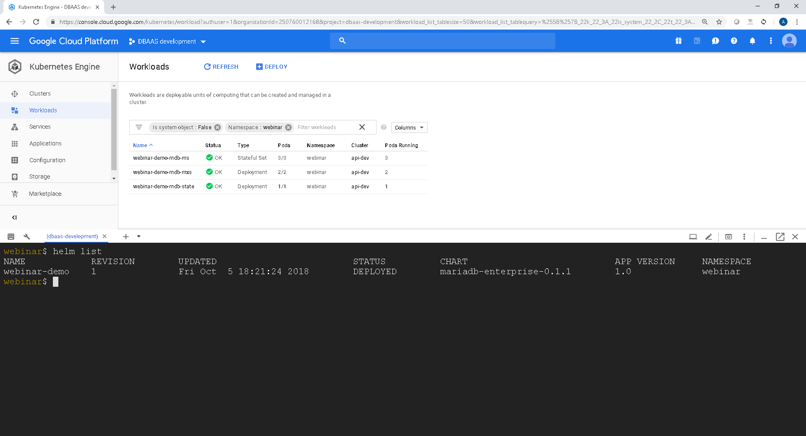
Deployments
StatefulSets

Slide 37
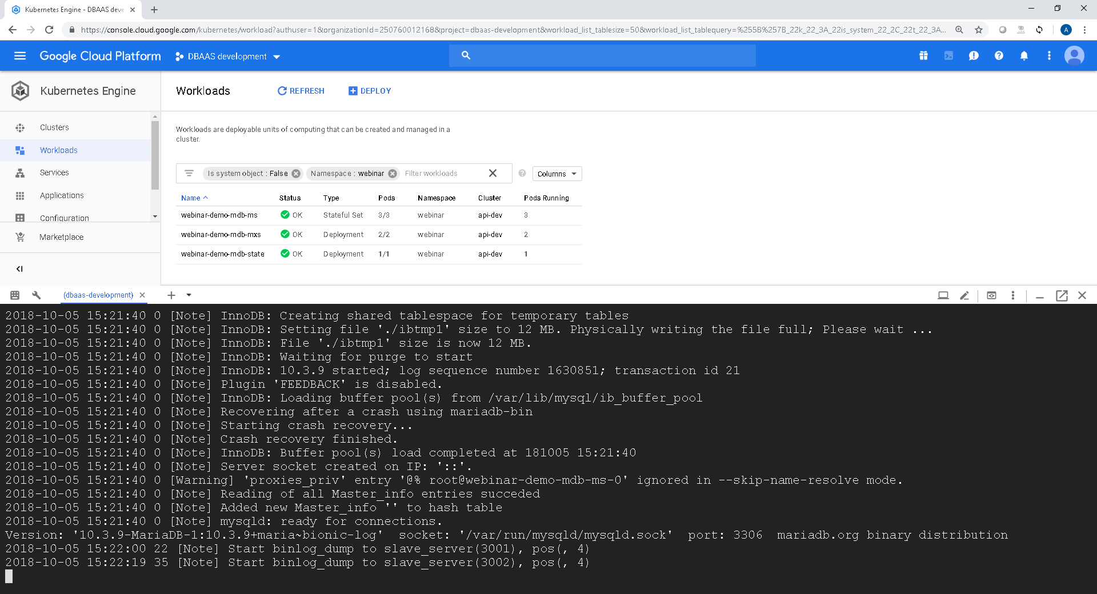

Logs
Master is ready to accept connections!
Notes:
the master node has been successfully added by two slaves

Slide 38
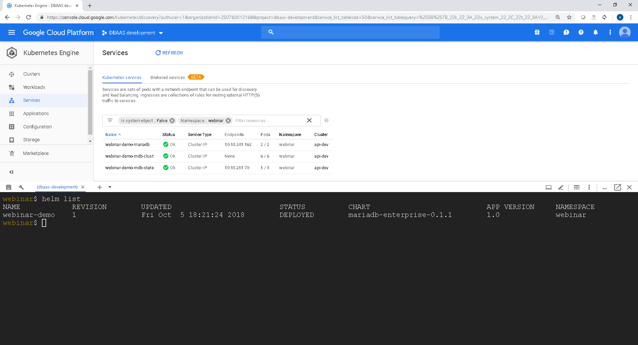

Services

Slide 39
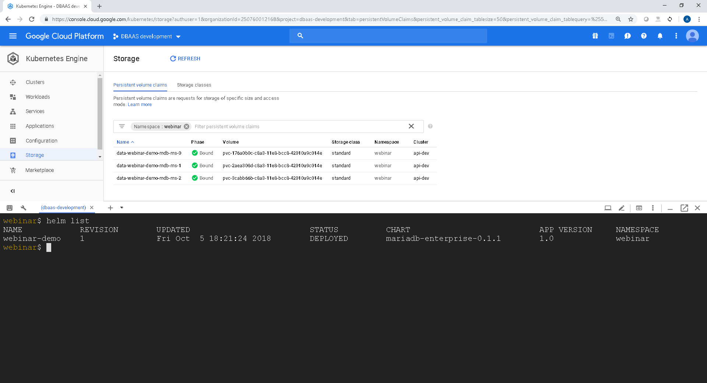
Persistent
Volumes

Slide 40
Future Directions
Helm Charts & Operators

Slide 41
Direction
Helm Chart
Enhance to support MariaDB Cluster Topologies.
Built on MariaDB Corporation Docker Hub images.
Easy to consume and deploy for dev / test environments.
Simple scaling using Kubectl / kubernetes dashboard.
Kubernetes Operator
Capturing MariaDB best practices in emerging SDK.
Support for 'Day 2' operations against MariaDB Cluster.
Advanced Operations (Backup/Recovery/Load Testing).
Advanced Scenarios (Disaster Recovery, Auto scaling).
Public and private cloud support.

Slide 42
Q & A

Slide 43
Official MariaDB Docker and Kubernetes Links
MariaDB Server docker & docker-compose sandbox
https://github.com/mariadb-corporation/mariadb-server-docker
MariaDB ColumnStore docker & docker-compose sandbox
https://github.com/mariadb-corporation/mariadb-columnstore-docker
Docker Hub Images
https://hub.docker.com/u/mariadb/
Kubernetes Master Slave Helm Chart: https://github.com/mariadb-corporation/mariadb-kubernetes
Notes:
Baking in all dependencies
Operating System
Code Dependencies

Slide 44
thomas.boyd@mariadb.com.

Slide 45

MariaDB Enterprise Service in Kubernetes
Deployment:
MaxScale instance
replicas: 2
Deployment:
StateStore
replicas: 1
StatefulSet:
MariaDB Server instance
replicas: 2
Service:
(maxs)
4006 (RW)
4008 (R)
Pod-0/1:
MaxScale
Pod-0:
Master
Pod-1:
Slave
Pod-0:
StateStore
jdbc:mariadb://
maxs:4006/DB
maxscaled
mysqld
mysqld
Client Application
prometheus
prometheus
prometheus
fluentd
fluentd
fluentd
Headless Service: clust
mariadb-0.clust
mariadb-1.clust
Going to redesign this one…
Persistent Volumes
mariadb-vol-0
mariadb-vol-1
Notes:
Three separate tiers:
MaxScale tier consisting (initially) of 2 MaxScale instances deployed in active/passive mode behind a load balancer (the external service). A Deployment is used to provide the load balancing.
MariaDB tier consisting (initially) of 3 MariaDB Servers bootstrapped in a 1 Master, 2 Slaves configuration. A StatefulSet is used to ensure a pod’s will survive failure.
StateStore tier consisting of 1 StateStore server that stores the current cluster configuration and assists the remaining tiers, through sidecar StateStore client containers, in configuring their internal state correctly (active/passive MaxScale, which servers are being monitored, which one is Master).

Slide 46
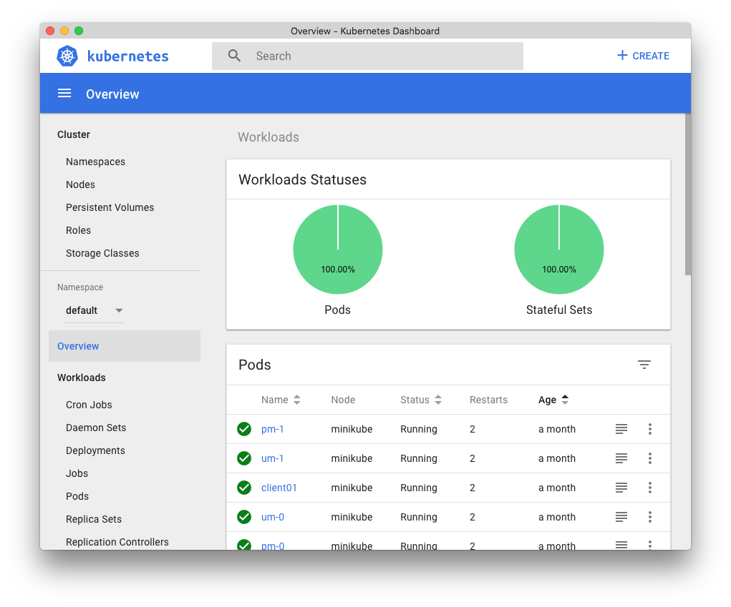
Kubernetes Components
volumes
containers
volumes
node
containers
node
volumes
kubernetes master(s)
kubernetes interfaces
containers
node
kubectl
REST
kubelet
docker
kubelet
Pod
docker
kubelet
docker
Notes:
K8s
A Node is a physical (or virtual) host where containers are executed
A container runtime (Docker) is available to run containers on the nodes. There are other options for the runtime environment and it can be even virtual instances.
The smallest unit of execution in k8s is a Pod which is a set of containers that share a file system, a network interface and a memory space.
Volumes are file systems managed by k8s that are mounted in the container’s file system. Persistent Volumes store data that survives a Pod restart. These are what we use

